Slide 1


Fabric and meta data and KQL magic
from REST API's to Insights
Kristian Bubalo & Meinrad Weiss
CSA Data & AI
CSU Switzerland

Slide 2
Where we started
I want to store, visualize and analyze stock data
From where do you get the data from?
I know some REST APIs and Python libraries, but don’t know how and where to store it. But once available, I can build a Power BI Report.
Let’s build a solution together!
We can learn a lot and share it within Microsoft and customers.

Slide 3
Requirement/Solution
Requirements | Solution
Fast and flexible analytics of the stock ticker and meta data | Eventhouse/KQL Database - Time series-oriented data store for our stock data Lakehouse - Data store for company related meta data
Regular refresh of the meta data and append of new stock information | Fabric Pipelines - Schedule (Trigger) Notebooks
List of collected stock can be easily changed by a business user | SQL Server database
End-to-end log information (kept for more than 30 days)
User friendly view of data using Dashboards/Reports | Power BI Realtime Dashboard (next release)
Get informed if anomalies occur on stocks | Data Activator (next release)

Slide 4
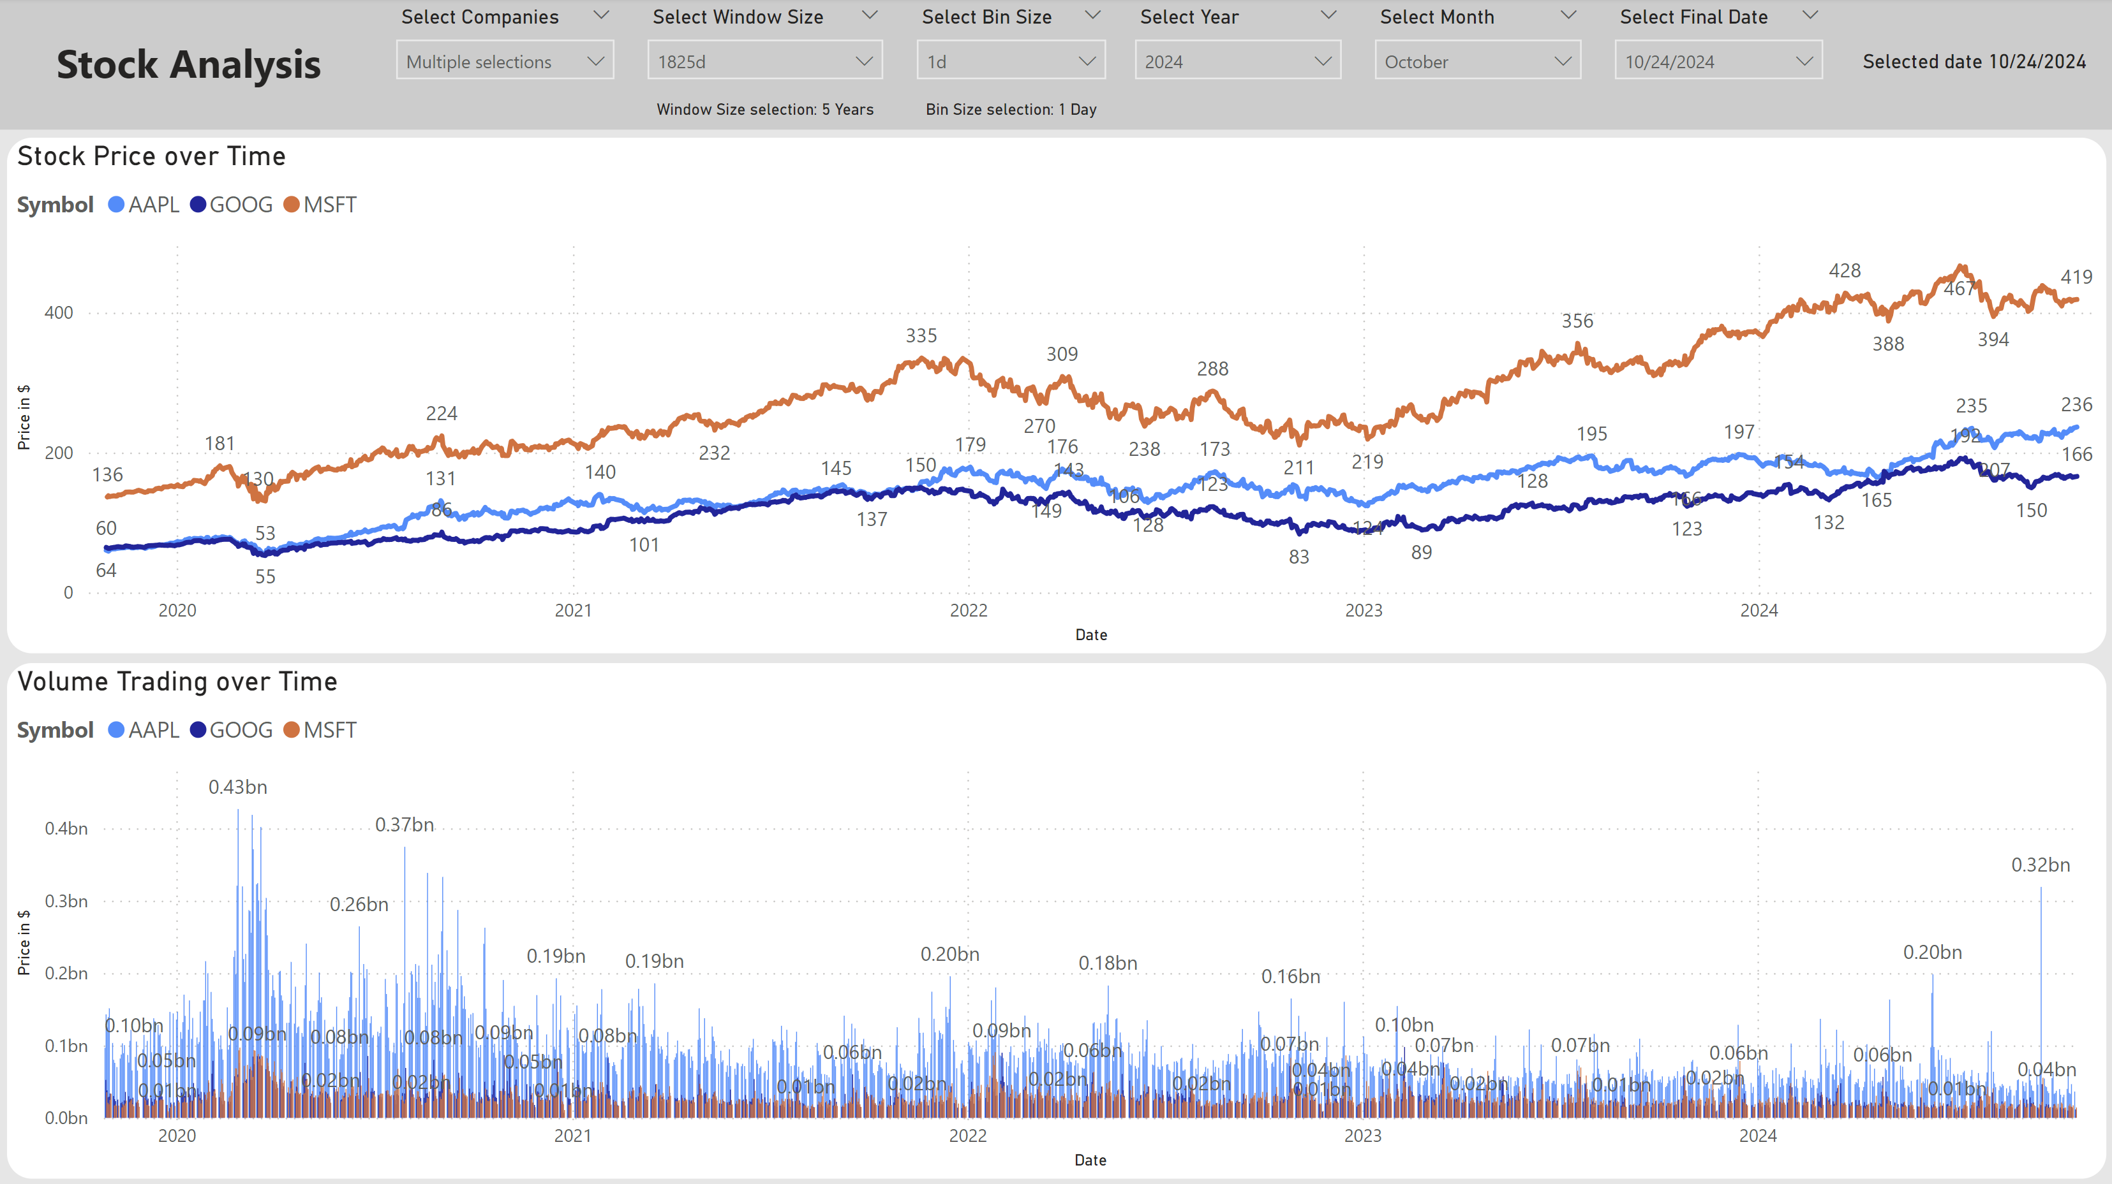

Slide 5
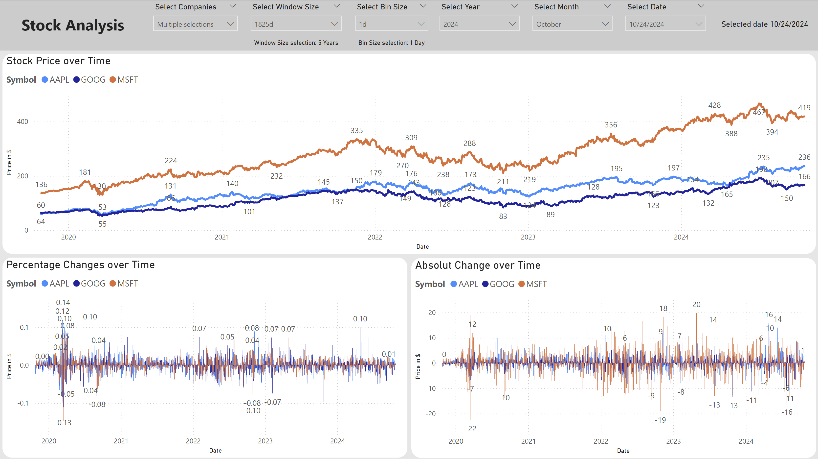

Slide 6
Important side note
We have built a reference application with the goal
of implementing a scalable and maintainable architecture, close to a real project, that optimally utilizes the strengths of the used fabric services
(write as few code as necessary). For "training purposes, and time limit" we have made some adjustments to the architecture in different areas, such as:
- Using human readable keys in the meta data database
- Transmitting JSON to the EventHouse (often the case in IoT scenarios)
- Reporting limited to Power BI (no Real-Time Dashboard, no Data Activator)

Slide 7
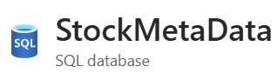
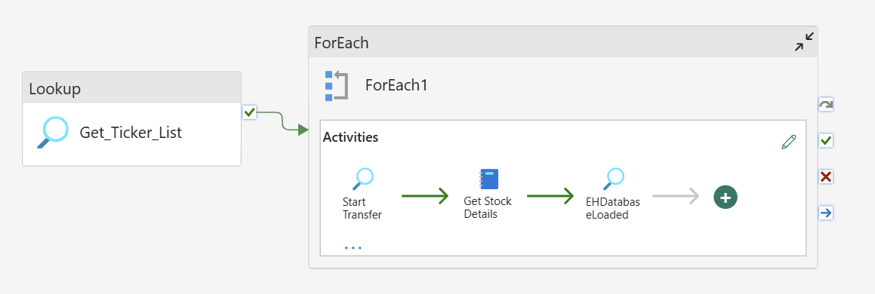
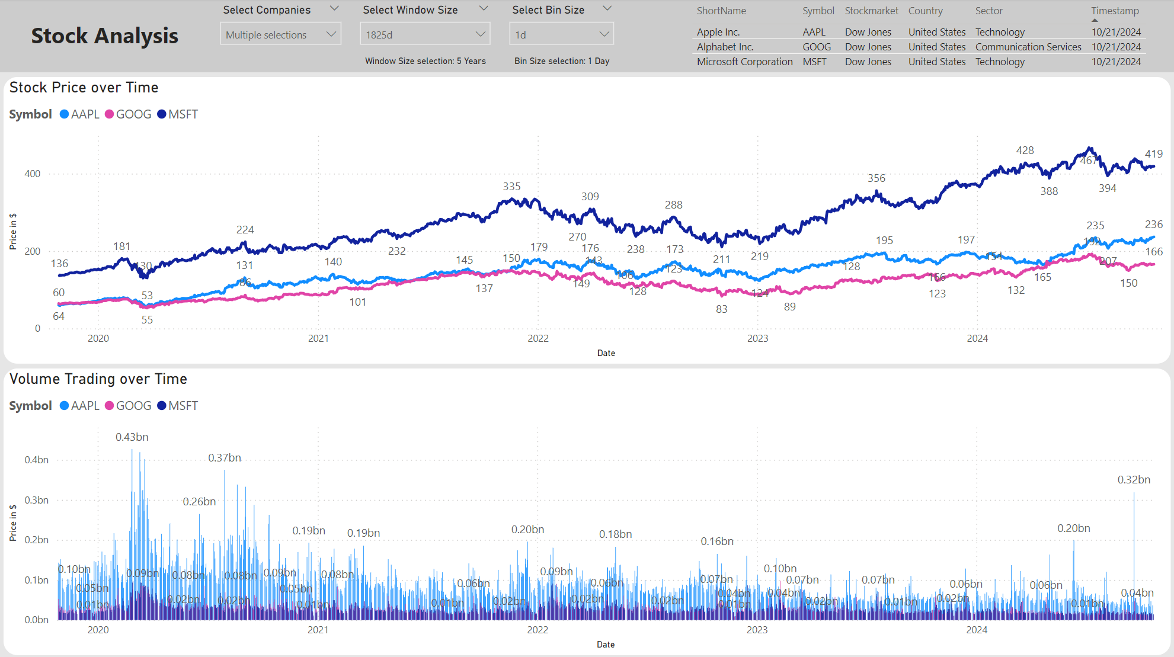
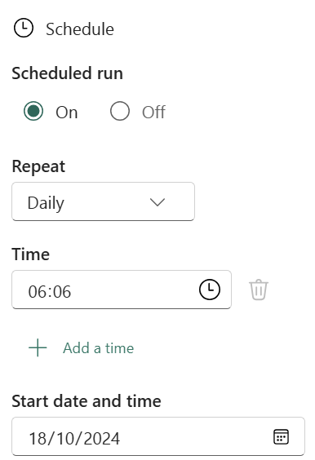
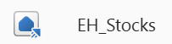
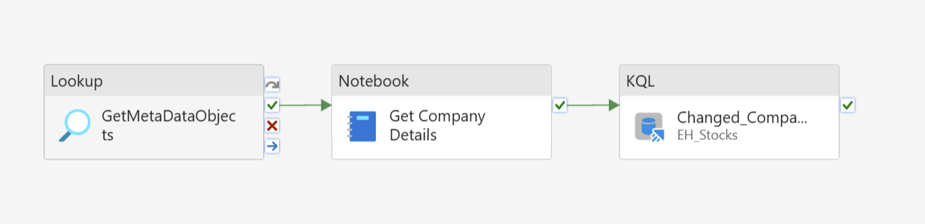
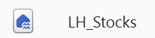







Our Solution
Pipeline runtime info
(Symbol, Start-, End-Window)
Detailed log information
(Start, #rows, End, Error)
EventHouse, KQL-DB
(Interactive analytics,
Power BI reports)
Get Stock Details
Bronze Company (Dimension)
- Stock data
(Ts, close, volume, …)
- Silver Company
Get Company Details
Microsoft Fabric
OneLake
(Sharing, ML training, …)
Data
Factory
Data
Engineering
Operational
Databases
Real Time Intelligence
Power BI
Data Activator
OneLake

Slide 8
Our Solution
Pipeline runtime info
(Symbol, Start-, End-Window)
Detailed log information
(Start, #rows, End, Error)
EventHouse, KQL-DB
(Interactive analytics,
Power BI reports)
Get Stock Details
Bronze Company (Dimension)
- Stock data
(Ts, close, volume, …)
- Silver Company
Get Company Details
Microsoft Fabric
OneLake
(Sharing, ML training, …)
Data
Factory
Data
Engineering
Operational
Databases
Real Time Intelligence
Power BI
Data Activator
OneLake

Slide 9
Fabric Data Pipeline, with Python Notebook
Fabric Data Pipelines are used to orchestrate the workflow
Key concepts in the implementation
Configuration of the pipeline is done outside of the pipeline
StockMetaData SQL database - tables
Optimal to store OLTP style data
Avoid coding logic within the pipeline
StockMetaData SQL database – stored procedures
Logic can be implemented in an efficient way
Easy to debug
Can be reused in different pipelines

Slide 10
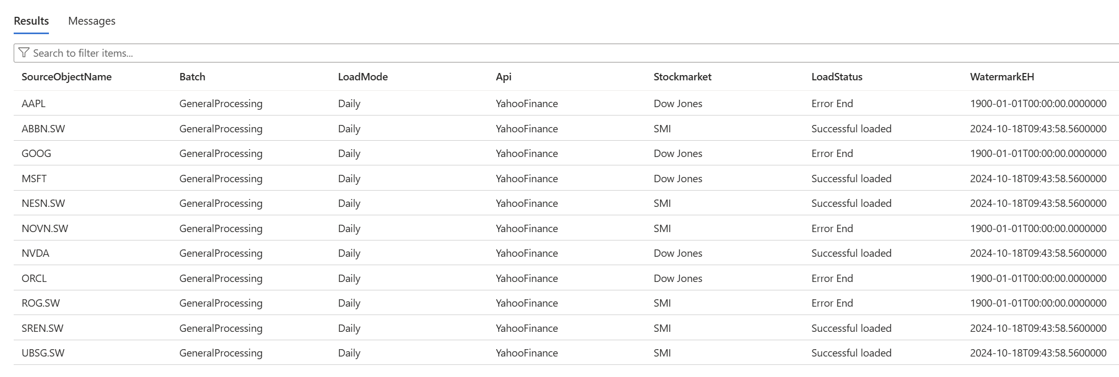
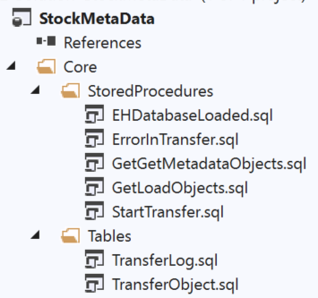
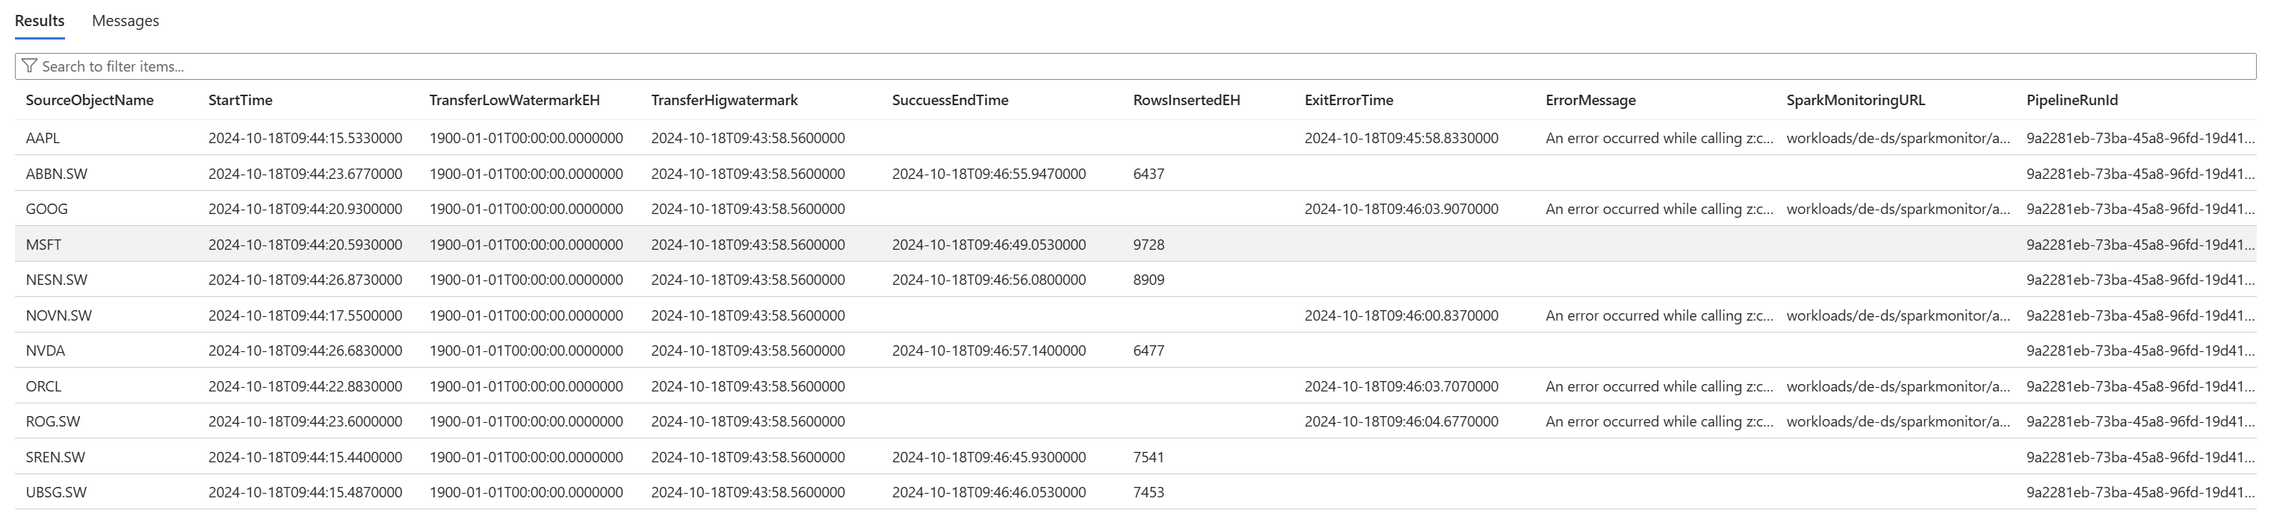
StockMetaData Objects

Slide 11
Handle data load windows, restart ability
Pattern can be used for «all» incremental loads with an increasing scalar attriute.
2024-10-16
2024-10-17
2024-10-18
MSFT
Stock data
Stock data
Stock data
2a
2b
Watermark
1
Stock data
ORCL
Stock data
Stock data
Watermark
Nothing happens regarding Watermark

Slide 12
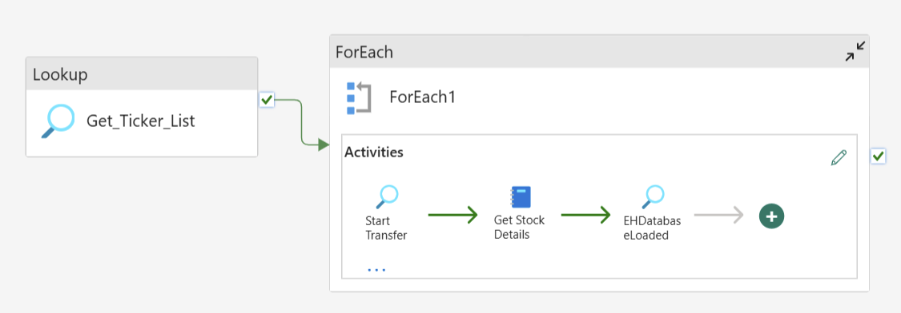
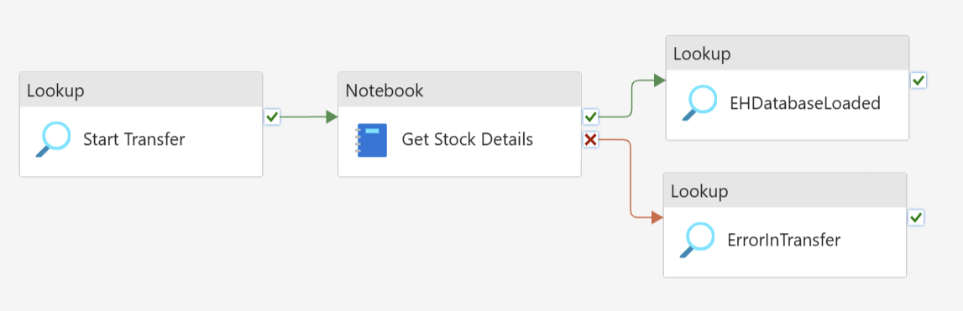
Pipeline and StockMetaData details

Slide 13
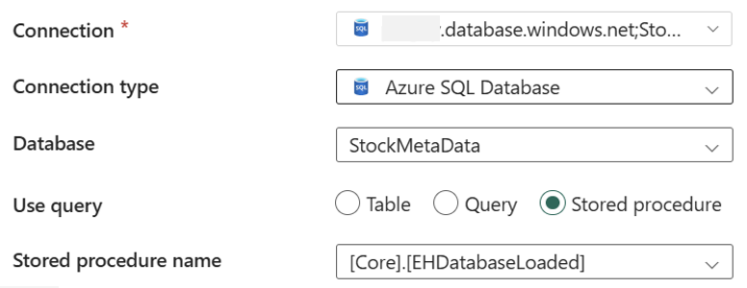
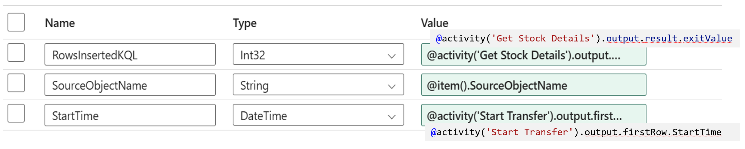
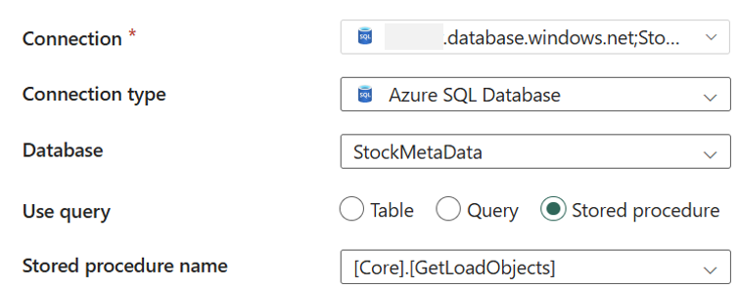
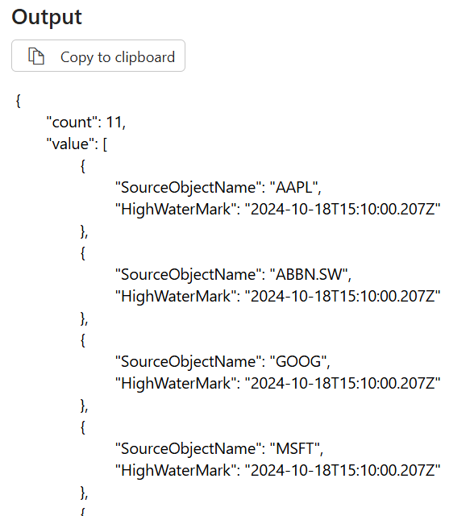
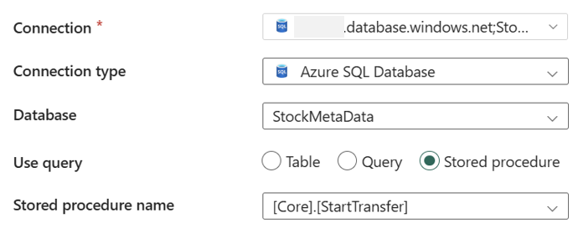
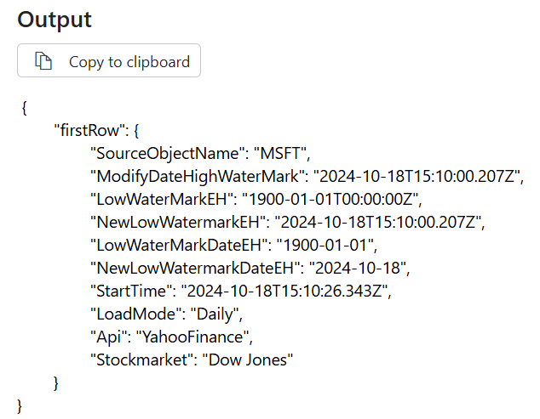
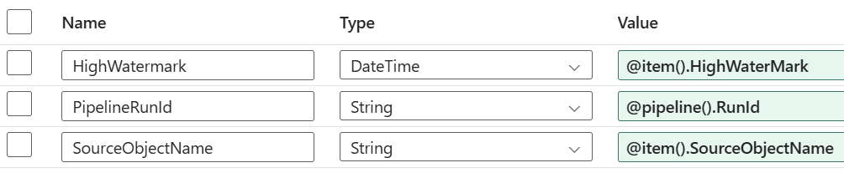
Pipeline and StockMetaData details

Slide 14
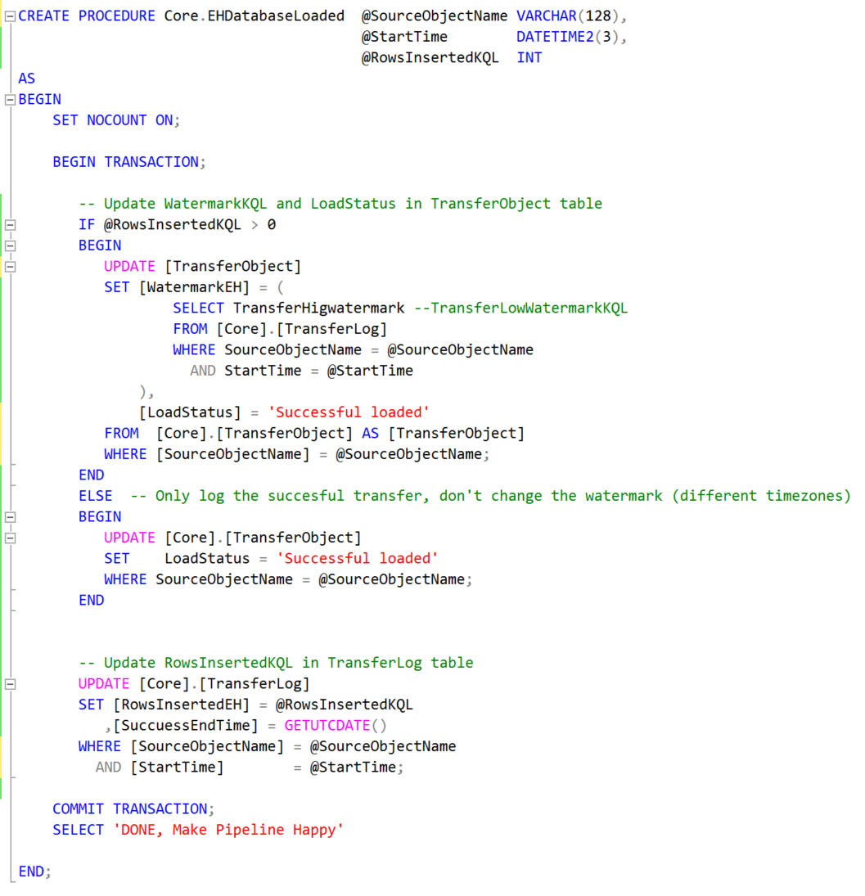
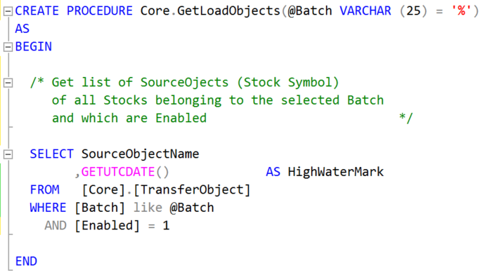
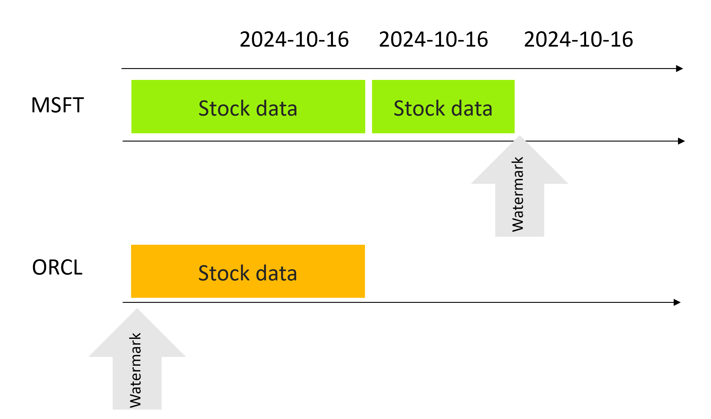
StockMetaData – Stored Procedures
A few, quite simple stored procedures provided the required transfer logic
Developed as a SQL database project

Slide 15
Our Solution
Pipeline runtime info
(Symbol, Start-, End-Window)
Detailed log information
(Start, #rows, End, Error)
EventHouse, KQL-DB
(Interactive analytics,
Power BI reports)
Get Stock Details
Bronze Company (Dimension)
- Stock data
(Ts, close, volume, …)
- Silver Company
Get Company Details
Microsoft Fabric
OneLake
(Sharing, ML training, …)
Data
Factory
Data
Engineering
Operational
Databases
Real Time Intelligence
Power BI
Data Activator
OneLake

Slide 16



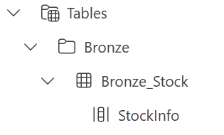
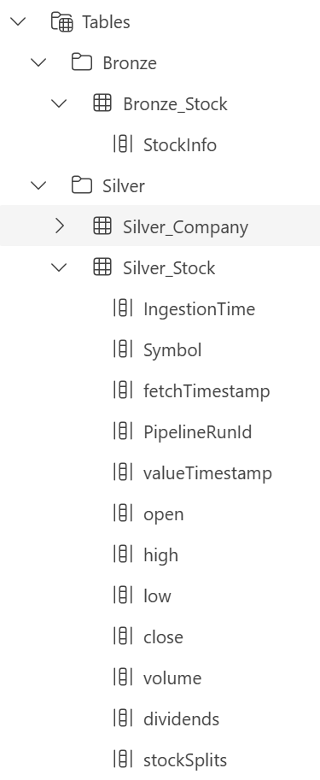
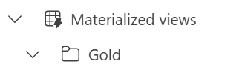

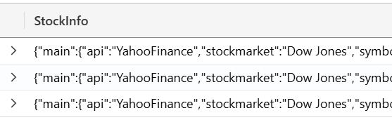
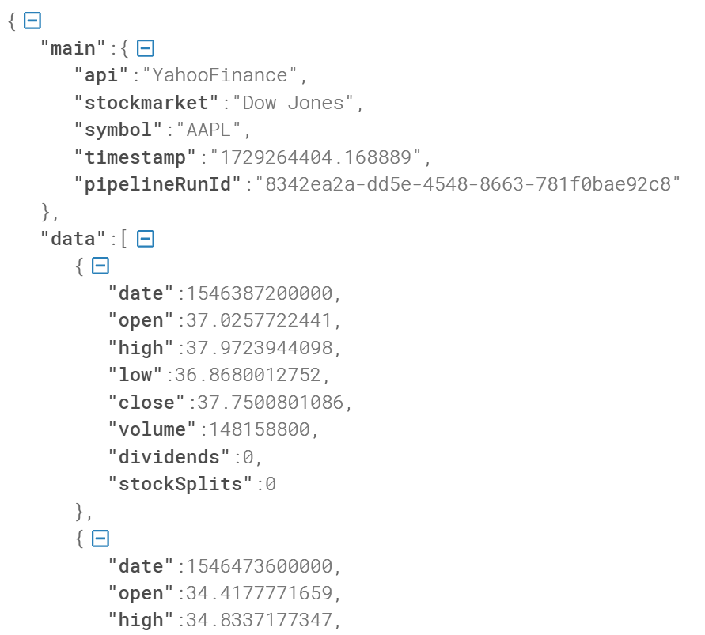
JSON Parsing, Update Policy and Materialized Views
KQL is used to transform and clean the data (build the medallion architecture)
KQL,
user defined functions
& update policy
Materialized views
Parse JSON
Define data types,
using KQL
Remove duplicate rows

Slide 17
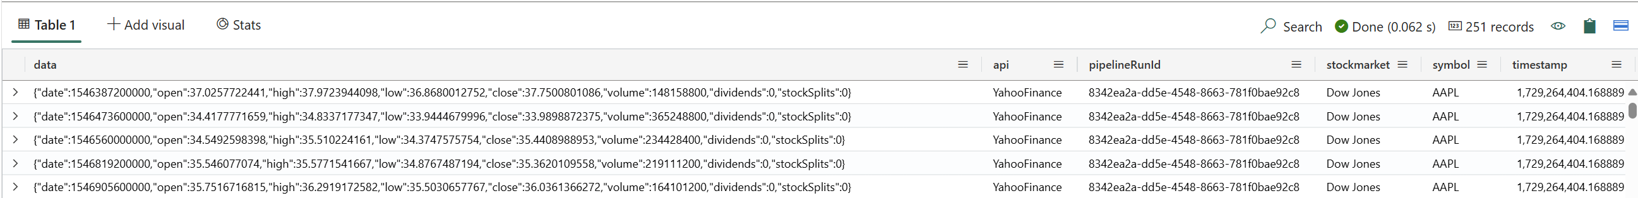
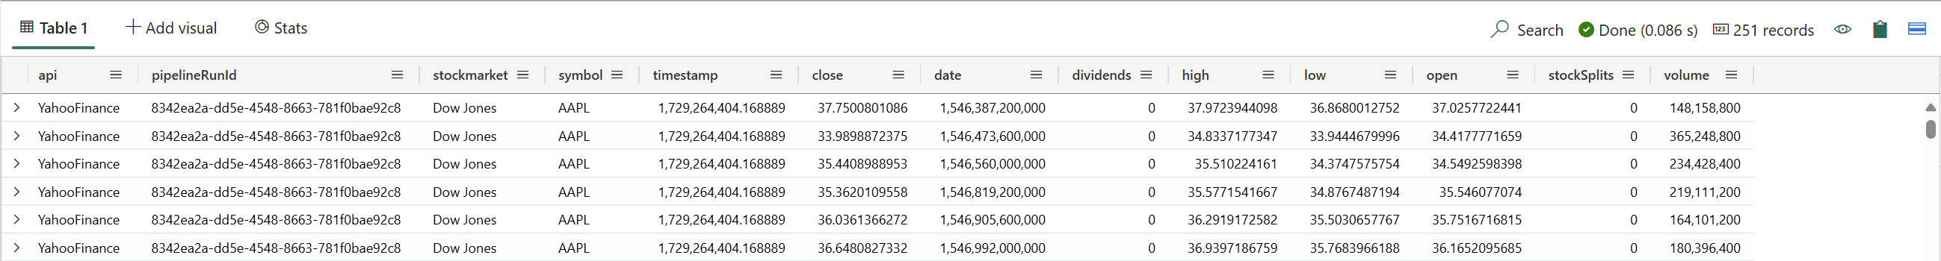
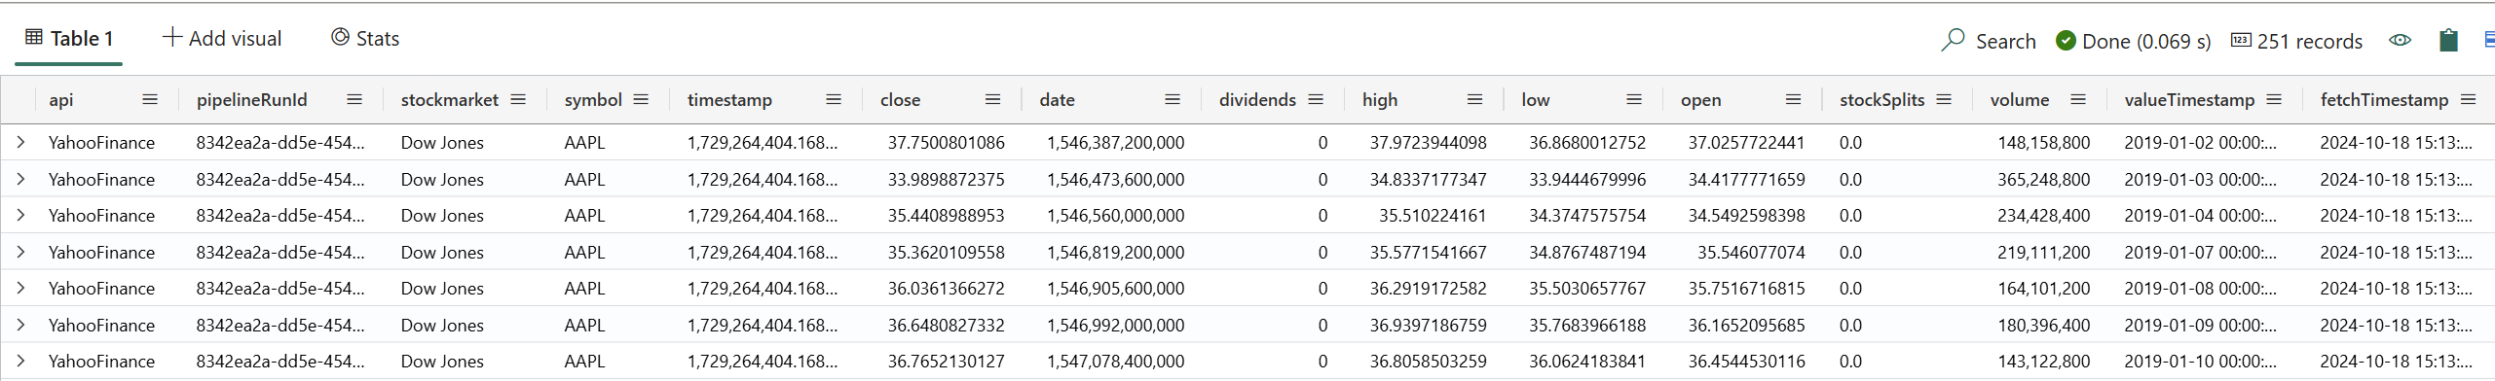
JSON Parsing and Update Policy
Bronze_Stock
| take 1
Bronze_Stock
| take 1
| evaluate bag_unpack(StockInfo)
Bronze_Stock
| take 1
| evaluate bag_unpack(StockInfo)
| evaluate bag_unpack(main)
Bronze_Stock
| take 1
| evaluate bag_unpack(StockInfo)
| evaluate bag_unpack(main)
| mv-expand data
Bronze_Stock
| take 1
| evaluate bag_unpack(StockInfo)
| evaluate bag_unpack(main)
| mv-expand data
| evaluate bag_unpack(data)
Bronze_Stock
| evaluate bag_unpack(StockInfo)
| evaluate bag_unpack(main)
| mv-expand data
| evaluate bag_unpack(data)
| extend valueTimestamp = unixtime_milliseconds_todatetime(tolong(['date']))
,fetchTimestamp = unixtime_seconds_todatetime(tolong(timestamp))
,stockSplits = tostring(stockSplits)

Slide 18
JSON Parsing and Update Policy - 2
The update policy will call the function Bronze_Parse_StockInfo()to transfom the incoming data in Bronze_Stock the silver structure and copy them to Silver_Stock (ELT Process).
Bronze_Stock
| evaluate bag_unpack(StockInfo)
| evaluate bag_unpack(main)
| mv-expand data
| evaluate bag_unpack(data)
| extend valueTimestamp = unixtime_milliseconds_todatetime(tolong(['date']))
,fetchTimestamp = unixtime_seconds_todatetime(tolong(timestamp))
,stockSplits = tostring(stockSplits)
| project-away ['date'], timestamp
.create-or-alter function with (folder = 'Bronze') Bronze_Parse_StockInfo()
{
Bronze_Stock
| evaluate bag_unpack(StockInfo)
| evaluate bag_unpack(main)
| mv-expand data
| evaluate bag_unpack(data)
| extend
valueTimestamp = unixtime_milliseconds_todatetime(tolong(['date']))
,fetchTimestamp = unixtime_seconds_todatetime(tolong(timestamp))
,stockSplits = tostring(stockSplits)
| project-away ['date'], timestamp
}
.alter table Silver_Stock policy update
@'[{"IsEnabled" : true
,"Source" : "Bronze_Stock« ,"Query" : "Bronze_Parse_StockInfo()« ,"IsTransactional" : true}]'

Slide 19
JSON Parsing and Update Policy - 3
Duplicate rows are a very common challenge in IoT projects (delivery at least once guarantee). The KQL functions arg_max()/take_any() and materialized-view are very helpful.
.create materialized-view with(folder = 'Gold’
,backfill = true) Gold_Stock on table Silver_Stock
{
Silver_Stock
| summarize arg_max(IngestionTime, *) by Symbol, valueTimestamp
}

Slide 20
Our Solution
Pipeline runtime info
(Symbol, Start-, End-Window)
Detailed log information
(Start, #rows, End, Error)
EventHouse, KQL-DB
(Interactive analytics,
Power BI reports)
Get Stock Details
Bronze Company (Dimension)
- Stock data
(Ts, close, volume, …)
- Silver Company
Get Company Details
Microsoft Fabric
OneLake
(Sharing, ML training, …)
Data
Factory
Data
Engineering
Operational
Databases
Real Time Intelligence
Power BI
Data Activator
OneLake

Slide 21
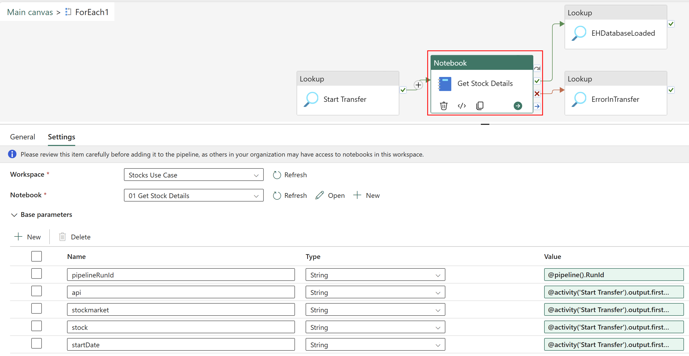
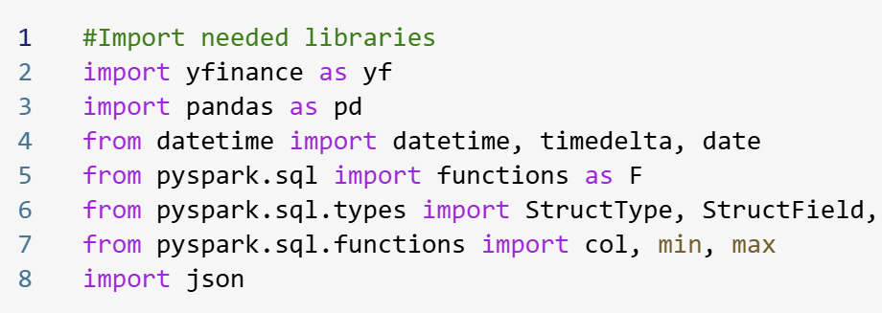
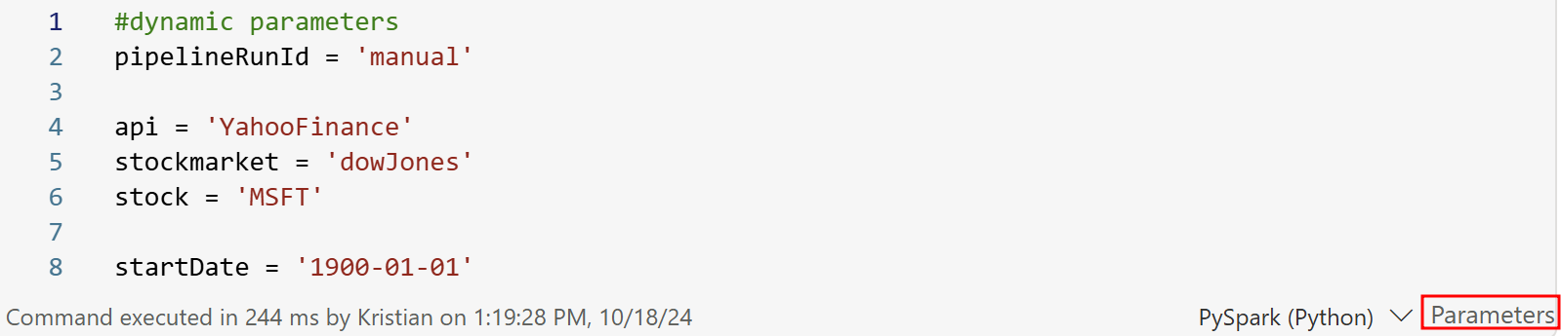
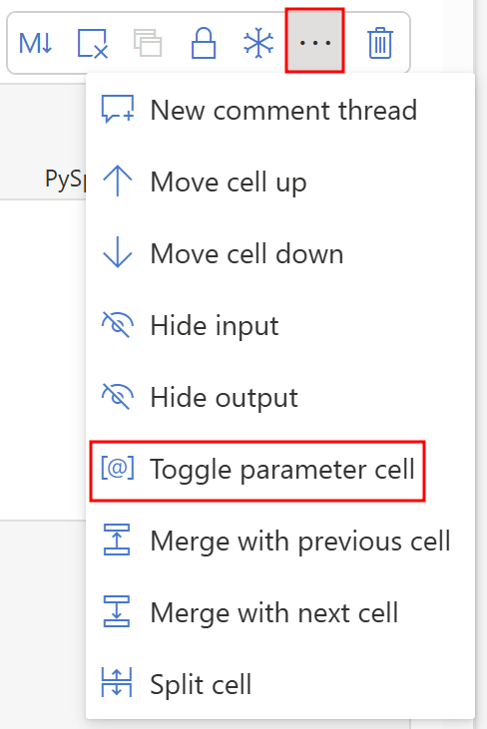
Python Code – Get Stock Details
Import required libraries
Define input parameters in parameter cell
1
2

Slide 22
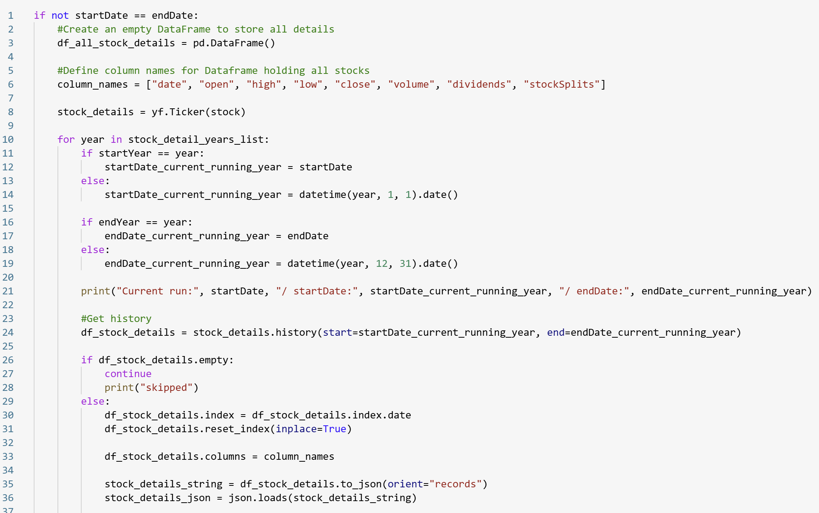
Python Code – Get Stock Details
3
Import required libraries
Define input parameters
Get stock details
Loop through each year to minimize JSON
Prepare data only if Dataframe is not empty
A
1
B
2

Slide 23
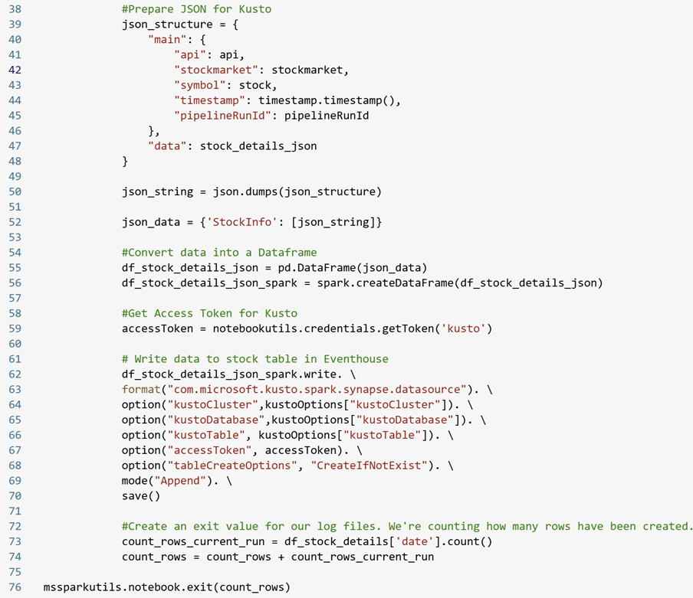
Python Code – Get Stock Details
4
Import required libraries
Define input parameters
Get stock details
Loop through each year to minimize JSON
Prepare data only if Dataframe is not empty
Prepare JSON structure for Kusto
Create a pySpark DataFrame to write to Kusto
Save data to Kusto
Create an exit parameter which is passed to the Pipeline
5
6
7

Slide 24
Python Code – Some notes
Very simple to pass parameter in and out
We specifically decided to convert data into JSON format for following reasons
Most IoT scenarios provide a JSON format
Kusto is great in handling JSON format like no other tool
Meta Data can be easily passed only once instead for each record
Bing combined with Copilot is giving outstanding support during development
Writing to Kusto is “a single line of code”
It’s not rocked science, but also not trivial as a few pitfalls can happen
JSON too large
Access Token expires
Keep naming convention
Implement incremental load (watermark)
Passing right parameter type
Understanding different formats (Dataframe, JSON), languages (Python, Pipeline Expressions), and technologies (Notebook, Pipelines)

Slide 25
Our Solution
Pipeline runtime info
(Symbol, Start-, End-Window)
Detailed log information
(Start, #rows, End, Error)
EventHouse, KQL-DB
(Interactive analytics,
Power BI reports)
Get Stock Details
Bronze Company (Dimension)
- Stock data
(Ts, close, volume, …)
- Silver Company
Get Company Details
Microsoft Fabric
OneLake
(Sharing, ML training, …)
Data
Factory
Data
Engineering
Operational
Databases
Real Time Intelligence
Power BI
Data Activator
OneLake

Slide 26
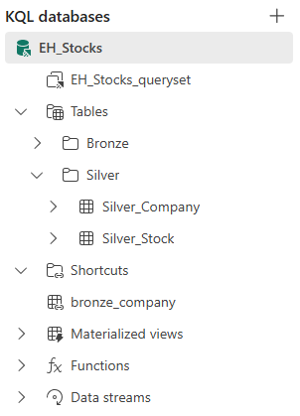
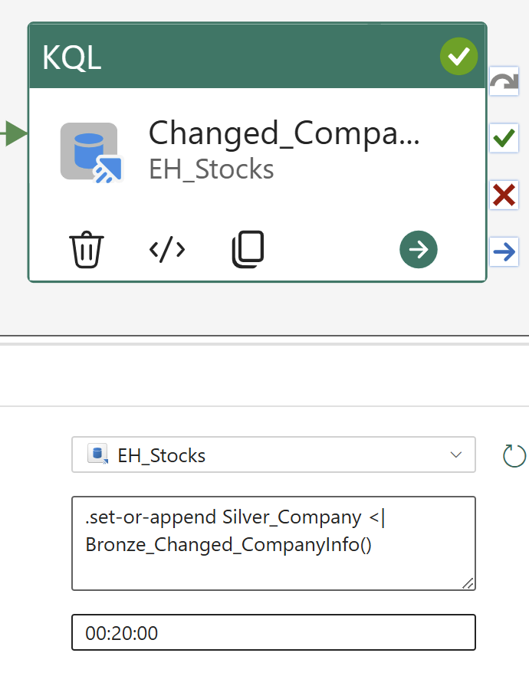
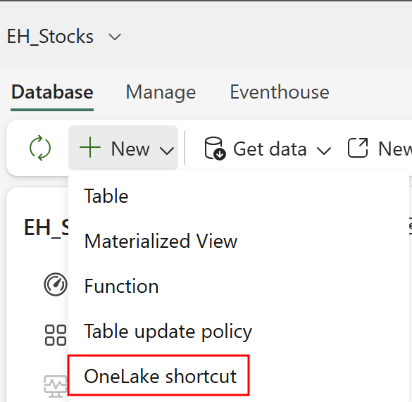
KQL Code – Get Company Details
Create a shortcut in Kusto pointing to Lakehouse
Use Shortcut to create table in Kusto .set-or-append Silver_Company <| Bronze_Changed_CompanyInfo()
1
2
.create-or-alter function with (folder = 'Bronze') Bronze_Changed_CompanyInfo()
{
external_table('bronze_company’)
| join kind=leftouter Company on Symbol
| extend BronzeHash = hash(strcat(ShortName, LongName, ..., Stockmarket))
| extend SilverHash = hash(strcat(ShortName1, LongName1, ..., Stockmarket1))
| where BronzeHash <> SilverHash
| project ShortName, LongName, Symbol, Address, City, ..., Stockmarket
}

Slide 27
Our Solution
Pipeline runtime info
(Symbol, Start-, End-Window)
Detailed log information
(Start, #rows, End, Error)
EventHouse, KQL-DB
(Interactive analytics,
Power BI reports)
Get Stock Details
Bronze Company (Dimension)
- Stock data
(Ts, close, volume, …)
- Silver Company
Get Company Details
Microsoft Fabric
OneLake
(Sharing, ML training, …)
Data
Factory
Data
Engineering
Operational
Databases
Real Time Intelligence
Power BI
Data Activator
OneLake

Slide 28



The performance “dilemma”
Goal is optimal query performance up to the latest arrived events, even if a small number of records are ingested
KQL Database
The optimal file size for a Parquet file in a Lakehouse processed by Spark can depend on various factors, including your specific setup and how the data will be used. However, here are some general guidelines:
File Size: Aim for around 256 MB - 1GB per file.
Lower Range: The lower limit is often set to avoid having too many small files, which can lead to excessive overhead during processing.
A common recommendation is to treat 32-64 MB as a minimum.
Upper Range: The upper limit is typically set to ensure efficient parallel processing.
One rule of thumb is to aim for around 1GB per file
OneLake
Lakehouse

Slide 29




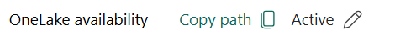


The performance “dilemma” - 2
Eventhouse
Lakehouse
SQL Endpoint
Shortcut
OneLake
Table
KQL Database
Spark
Fabric or Databricks
Adaptive behavior
Eventhouse offers a robust mechanism that intelligently batches incoming data streams into one or more Parquet files, structured for analysis. Batching data streams is important when dealing with trickling data. Writing many small Parquet files into the lake can be inefficient resulting in higher costs and poor performance.
Eventhouse's adaptive mechanism can delay write operations for up to a few hours if there isn’t enough data
to create optimal Parquet files. This ensures Parquet files are optimal in size and adhere to Delta Lake best practices.
The Eventhouse adaptive mechanism ensures that the Parquet files are primed for analysis and balances the need for
prompt data availability with cost and performance considerations.

Slide 30
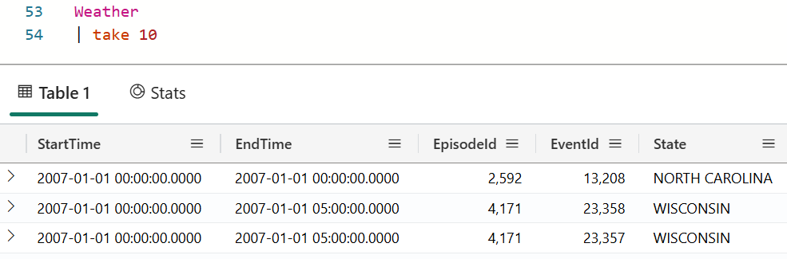
Eventhouse and OneLake
Eventhouse
Lakehouse
SQL Endpoint
Shortcut
KQL Database
OneLake
Table
Spark
Fabric or Databricks
Run KQL (SQL) queries to analyze data
See latest and greatest data
Read from tables, materialized views and functions
Leverage all KQL functions
Result set size should be < 500’000 rows and 64 MB
Run SQL/Spark queries to analyze data
See replicated data
Only tables are mirrored (no functions or mv’s)
Resultset size can be > 500’000 rows and 64 MB -> e.g. source for machine learning
Spark
Fabric or Databricks

Slide 31
Our Solution
Pipeline runtime info
(Symbol, Start-, End-Window)
Detailed log information
(Start, #rows, End, Error)
EventHouse, KQL-DB
(Interactive analytics,
Power BI reports)
Get Stock Details
Bronze Company (Dimension)
- Stock data
(Ts, close, volume, …)
- Silver Company
Get Company Details
Microsoft Fabric
OneLake
(Sharing, ML training, …)
Data
Factory
Data
Engineering
Operational
Databases
Real Time Intelligence
Power BI
Data Activator
OneLake

Slide 32
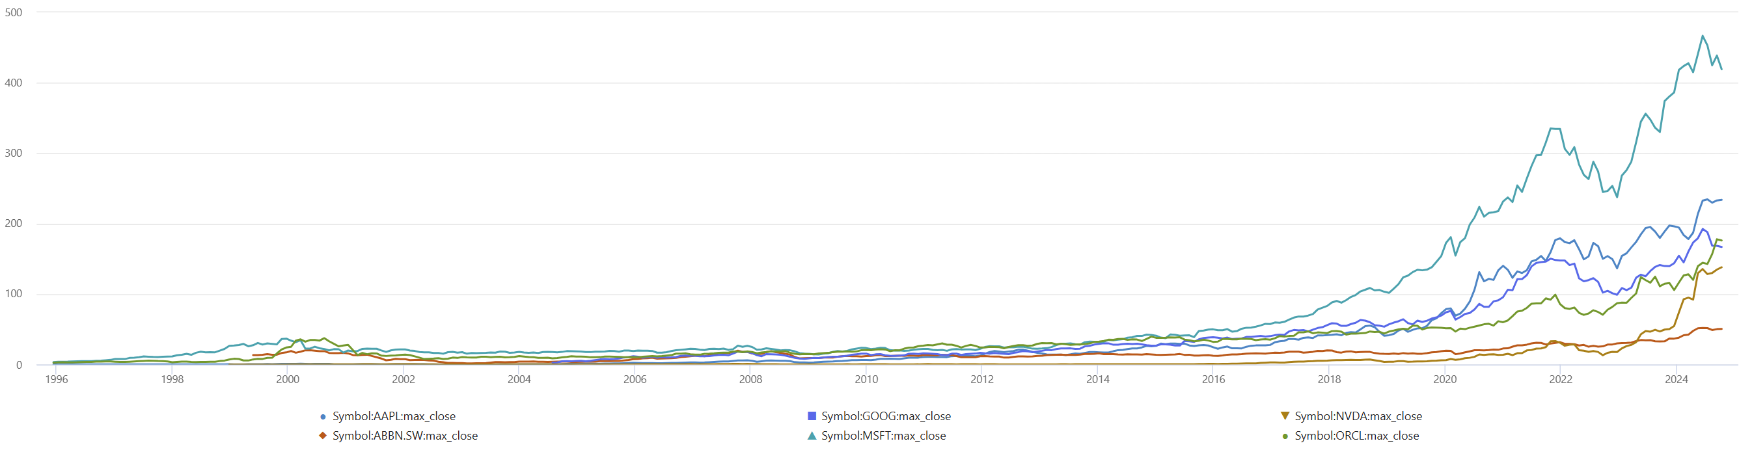
KQL Magic
Stock
| where Symbol in ('AAPL', 'MSFT', 'ORCL', 'NVDA', 'ABBN.SW', 'GOOG')
| where valueTimestamp > datetime(1996-01-01)
| summarize max(close) by Symbol, bin(valueTimestamp, 30d)
| render linechart with(xcolumn=valueTimestamp, series=Symbol)

Slide 33
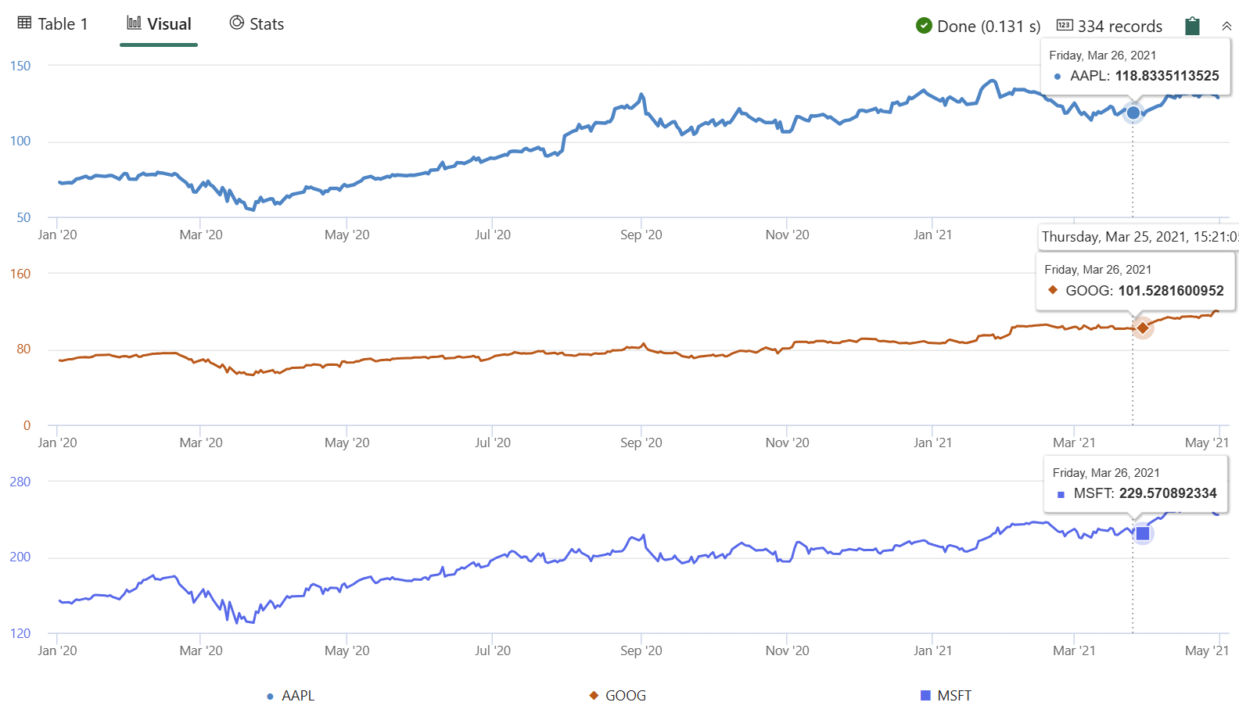
KQL Magic – Compare some shares
Gold_Stock
| where valueTimestamp between (datetime(2020-01-01) .. datetime(2021-05-01)) and Symbol in('AAPL', 'GOOG', 'MSFT')
| project Symbol, valueTimestamp, close
| evaluate pivot(Symbol, any(close))
| render timechart with(ysplit=panels)

Slide 34
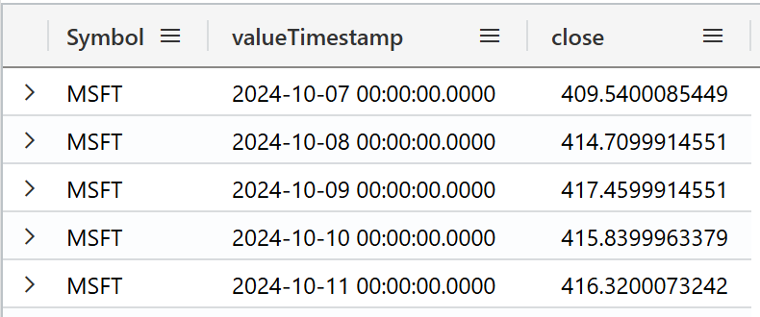
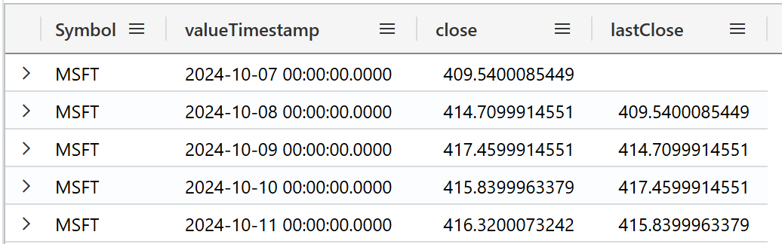
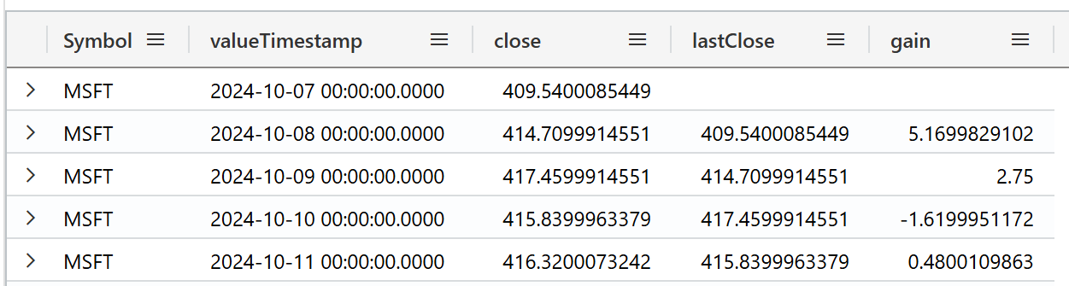
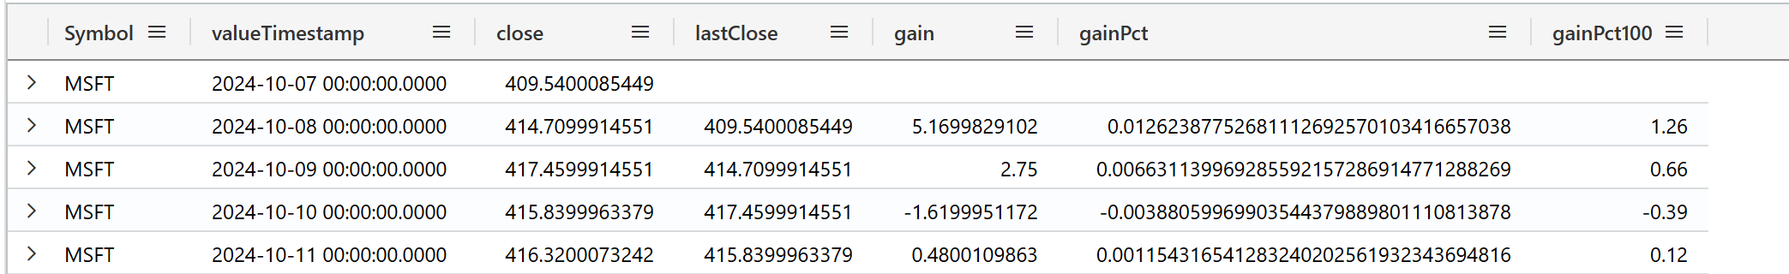
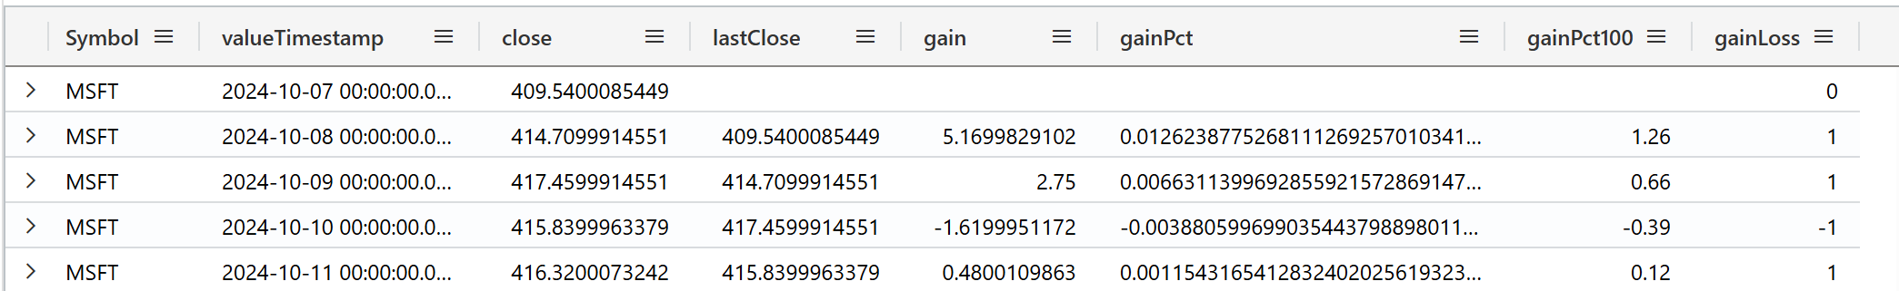

KQL Magic – add derived values
Gold_Stock provides correct numbers, but we just get the close value, but not the gain for each day.
A few lines of KQL let us create this calculate columns
Gold_Stock
| project Symbol, valueTimestamp, close
| where Symbol == "MSFT"
| order by valueTimestamp desc
| take 10
| order by Symbol, valueTimestamp asc
Gold_Stock
| project Symbol, valueTimestamp, close
| where Symbol == "MSFT"
| order by valueTimestamp desc
| take 10
| order by Symbol, valueTimestamp asc
| extend lastClose = prev(close)
Gold_Stock
| project Symbol, valueTimestamp, close
| where Symbol == "MSFT"
| order by valueTimestamp desc
| take 10
| order by Symbol, valueTimestamp asc
| extend lastClose = prev(close)
| extend gain = close - lastClose
Gold_Stock
| project Symbol, valueTimestamp, close
| where Symbol == "MSFT"
| order by valueTimestamp desc
| take 10
| order by Symbol, valueTimestamp asc
| extend lastClose = prev(close)
| extend gain = close - lastClose
| extend gainPct = gain/lastClose
Gold_Stock
| project Symbol, valueTimestamp, close
| where Symbol == "MSFT"
| order by valueTimestamp desc
| take 10
| order by Symbol, valueTimestamp asc
| extend lastClose = prev(close)
| extend gain = close - lastClose
| extend gainPct = gain/lastClose
| extend gainPct100 = round(gainPct * 100,2)
Gold_Stock
| project Symbol, valueTimestamp, close
| where Symbol == "MSFT"
| order by valueTimestamp desc
| take 10
| order by Symbol, valueTimestamp asc
| extend lastClose = prev(close)
| extend gain = close - lastClose
| extend gainPct = gain/lastClose
| extend gainPct100 = round(gainPct * 100,2)
| extend gainLoss = iif(gain > 0,1,iif(gain<0,-1,0))

Slide 35

KQL Magic
Gold_Stock provides correct numbers, but we just get the close value, but not the gain for each day.
A few lines of KQL let us create this calculate columns
.create-or-alter function with (folder="Gold") Stock ()
{
Gold_Stock
| project Symbol, valueTimestamp, close
| where Symbol == "MSFT"
| order by valueTimestamp desc
| partition by Symbol
(
order by valueTimestamp asc
| extend lastClose = prev(close)
| extend gain = close - lastClose
| extend gainPct = gain/lastClose
| extend gainPct100 = round(gainPct * 100,2)
| extend gainLoss = iif(gain > 0,1,iif(gain<0,-1,0))
| project-away lastClose
)
}

Slide 36


KQL Magic - series_fill_(forward, linear, …)
Stock
| where valueTimestamp between(datetime(2023-10-26) .. datetime(2023-11-17))
| make-series sValue = take_any(close) default=real(null)on valueTimestamp step 1d by Symbol
| render linechart with(xcolumn=valueTimestamp, series=Symbol)
Stock
| where Symbol in ('MSFT')
| where valueTimestamp between (datetime(2023-10-26) .. datetime(2023-11-17))
| make-series sValue = take_any(close) default=real(null) on valueTimestamp step 1d by Symbol
| render linechart with(xcolumn=valueTimestamp, series=Symbol)

Slide 37


KQL Magic – series_fill_(forward, linear, …)
Stock
| where Symbol in ('MSFT')
| where valueTimestamp between (datetime(2023-10-26) .. datetime(2023-11-17))
| make-series sValue = take_any(close) default=real(null) on valueTimestamp step 1d by Symbol
| render linechart with(xcolumn=valueTimestamp, series=Symbol)
| extend sValue = series_fill_forward(sValue)
| render linechart with(xcolumn=valueTimestamp, series=Symbol)

Slide 38

KQL Magic – highest pct increase in “row” per each stock
Gold_Stock
| where valueTimestamp >= datetime(2019-01-01) and Symbol in('AAPL', 'GOOG', 'MSFT')
| partition by Symbol
(
order by valueTimestamp asc
| extend pValueTimestamp=prev(valueTimestamp), pClose=prev(close)
| extend delta = close - pClose
| scan with_match_id=m_id declare(down:bool=false, step:string) with
(
// if state of s1 is empty we require price increase, // else continue as long as price doesn't decrease
step s1: delta >= 0 and (delta > 0 or isnotnull(s1.delta)) => step = 's1';
// exit the 'rally' when price decrease, also forcing a single match
step s2: delta < 0 and s2.down == false => down = true, step = 's2';
)
)
| where step == 's1' // select only records with price increase
| summarize (start_date, start_Close, start_delta)=arg_min(pValueTimestamp, pClose, delta)
, end_date=max(pValueTimestamp), trading_days=count(), total_delta=sum(delta) by Symbol, m_id
| extend delta_pct = total_delta*100.0/start_Close
| summarize arg_max(delta_pct, *) by Symbol
| project Symbol, start_date, end_date, trading_days, delta_pct, start_Close, total_delta
| order by delta_pct
Notes:
The new SCAN Operator: Process Mining in Azure Data Explorer - Microsoft Community Hub

Slide 39





Some ADX Functions
Time Series Analysis - Azure Data Explorer | Microsoft Learn

Slide 40



Some ADX Functions (Geospacial)
Support for geospatial clustering
Transformation from coordinates to geospatial clusters and back
Support for Geohash, S2 and H3 cells
Distance
Calculate the distance between two points or a point and a line
Contains
Check whether a point is in a given circle or polygon
Advanced features
Densification to control shape edges, geodesics or straight lines
H3-Rings
Geospatial coordinates are interpreted as represented per the WGS-84 reference system.

Slide 41
Our Solution
Pipeline runtime info
(Symbol, Start-, End-Window)
Detailed log information
(Start, #rows, End, Error)
EventHouse, KQL-DB
(Interactive analytics,
Power BI reports)
Get Stock Details
Bronze Company (Dimension)
- Stock data
(Ts, close, volume, …)
- Silver Company
Get Company Details
Microsoft Fabric
OneLake
(Sharing, ML training, …)
Data
Factory
Data
Engineering
Operational
Databases
Real Time Intelligence
Power BI
Data Activator
OneLake

Slide 42


Power BI – Overview Page
The Overview Page connects to 3 tables
Dim_Company
Dim_Company_Timestamp
Fact_GetStock
Relationship between dim and fact tables created via “Symbol” column
Two helper Tables have been created to pass parameter directly to Kusto Query in M (PowerQuery) – no relationship created!
Param_WindowSize
Param_BinSize
Param_Date

Slide 43





Overview Page M fact_GetStock
Connect to Kusto using Azure Data Explorer (Kusto) Connector with following KQL GetStock(now(), '10y', '30d')
Create required Parameters
Update M Code replacing hardcoded text with Parameters
1
2
3
Run the calculation on
filtered and pre-aggregated
data set.

Slide 44





Overview Page M fact_GetStock
Connect to Kusto using Azure Data Explorer (Kusto) Connector with following KQL GetStock(now(), '10y', '30d')
Create required Parameters
Update M Code replacing hardcoded text with Parameters
Close & Apply
Switch to Model View
Select column from helper Table and Bind to correct parameter
Repeat for Window Size parameter and Date parameter
3
4
5
6
6

Slide 45


Overview Page M dim_Company
Connect to Kusto using Azure Data Explorer (Kusto) Connector with following KQL Company
Update M Code replacing hardcoded text with Parameters
Mark table as dimension to boost performance Following best practice when joining a large table (Fact) with a much smaller table (Dimension) is to mention the small table first. This setting will make that sure.
1
2
3

Slide 46

Power BI – Detailed Analysis Page
Slicer functionality is limited if you bind a field to a parameter and force single selection
Search functionality in Slicer Visual not available neither
As workaround use “pre-filters” like Year and Month → Final date must be selected after changing Year / Month
Help End User showing selected values or show a warning message after changing Year / Month Slicer by using DAX
Selected Date Range =
IF (
ISBLANK ( SELECTEDVALUE ( Param_Date[Date] ) ),
"Please select a specific date",
"Selected date " & SELECTEDVALUE ( Param_Date[Date] )
)

Slide 47


GetStock – Get Data Window
31 Days
2025-01-10

Slide 48

GetStock – Fill the gaps forward

Slide 49

GetStock – Bin data (4 days)

Slide 50

GetStock – Bin data (4 days)

Slide 51



GetStock – Calculate Growth
Gain
Gain

Slide 52
Our Solution
Pipeline runtime info
(Symbol, Start-, End-Window)
Detailed log information
(Start, #rows, End, Error)
EventHouse, KQL-DB
(Interactive analytics,
Power BI reports)
Get Stock Details
Bronze Company (Dimension)
- Stock data
(Ts, close, volume, …)
- Silver Company
Get Company Details
Microsoft Fabric
OneLake
(Sharing, ML training, …)
Data
Factory
Data
Engineering
Operational
Databases
Real Time Intelligence
Power BI
Data Activator
OneLake

Slide 53

Our Solution

Slide 54

Our Solution

Slide 55
Next Steps
Use Data Activator to get notification on significant price drops / gains
Migrate Azure SQL to SQL within Fabric once available
A series of blog posts walking through the whole solution will be published in the upcoming weeks on https://aka.ms/PBIGuyBlog

Slide 56

Conclusion
From a technology point of view
Very easy to integrate each item with each other within Microsoft Fabric
No network related configuration required, no secrets to maintain, …
All necessary items supported in Microsoft Fabric
Different skills & languages required
Data Factory, Notebook, Lakehouse, Azure SQL, Kusto, Power BI
Expression Language, Python, T-SQL, KQL, DAX, M (Power Query)
Technology is important, but it’s not the only one:
Domain expertise should be part of the team, shape to solution according to business requirements → make sense out of data
Our finding, it’s quite some ground to be covered:
Collaboration – Work in a team (2-3 members), profit from each other!
Work iterative to achieve goal

Slide 58
Appendix

Slide 59





Python Code – Get Company Details
Import required libraries
Define global parameters
Define internal Parameters
Define function to get and transform result as needed
Call function to get Company details for each company
Save result into Lakehouse
4
1
5
2
3
6

Slide 60



Overview Page M dim_Company_Timestamp
Connect to Kusto using Azure Data Explorer (Kusto) Connector with following KQL Gold_Stock_Symbol
Update M Code replacing hardcoded text with Parameters
Mark table as dimension to boost performance Following best practice when joining a large table (Fact) with a much smaller table (Dimension) is to mention the small table first. This setting will make that sure.
1
2
3

Slide 61
Power BI – Overview Page M fact_GetStock
let
Source = AzureDataExplorer.Contents(
#"Kusto Cluster URI" //Kusto Cluster URL
,#"Kusto DB" //Kusto Database Name
,null //Define if table or query, default = null
,null //Define null if Fact Table
),
GetStock = Source{[Name="GetStock"]}[Data],
#"Invoked FunctionGetStock" = GetStock(DateTime.ToText(Date, "yyyy-MM-dd hh:mm"), WindowSize, BinSize)
in
#"Invoked FunctionGetStock"

Slide 62
Power BI – Overview Page M dim_Company
let
Source = AzureDataExplorer.Contents(
#"Kusto Cluster URI" //Kusto Cluster URL
,#"Kusto DB" //Kusto Database Name
,null //Define if table or query, default = null
,[ //Define options as table
MaxRows=null
,MaxSize=null
,NoTruncate=null
,AdditionalSetStatements=null
,IsDimension=true //Set this option to true on Dimension tables
]
),
Company = Source{[Name="Company"]}[Data]
in
Company

Slide 63
Power BI – Overview Page M dim_CompanyTimestamp
let
Source = AzureDataExplorer.Contents(
#"Kusto Cluster URI" //Kusto Cluster URL
,#"Kusto DB" //Kusto Database Name
,null //Define if table or query, default = null
,[ //Define options as table
MaxRows=null
,MaxSize=null
,NoTruncate=null
,AdditionalSetStatements=null
,IsDimension=true //Set this option to true on Dimension tables
]
),
Gold_Stock_Symbol = Source{[Name="Gold_Stock_Symbol"]}[Data]
in
Gold_Stock_Symbol

Slide 64
Power BI – Overview Page M Param_WindowSize
let
Source = Table.FromRows(Json.Document(Binary.Decompress(Binary.FromText("i45WMkxR0lEyBGEFl8RKpVidaCVTkJAREJuChIrBYsYGIEFjsDrf/LySDLCooQVY2ASIzSDCUNVmYDNMwcojUxOLoKqNwMJmYKNBwnDVYGPMQcoN0CTAMhZgGbhULAA=", BinaryEncoding.Base64), Compression.Deflate)), let _t = ((type nullable text) meta [Serialized.Text = true]) in type table [#"Window Size" = _t, Sorting = _t, Explanation = _t]),
#"Changed Type" = Table.TransformColumnTypes(Source,{{"Sorting", Int64.Type}})
in
#"Changed Type"

Slide 65
Power BI – Overview Page M Param_BinSize
let
Source = Table.FromRows(Json.Document(Binary.Decompress(Binary.FromText("i45WMkxR0lEyBGEFl8RKpVidaCVTkJAREJuChIrBYsYGIEFjsDrf/LySDLCooQVY2ASIzSDCUNVmYDNMwcojUxOLoKqNwMJmYKNBwnDVYGPMQcoNYBKxAA==", BinaryEncoding.Base64), Compression.Deflate)), let _t = ((type nullable text) meta [Serialized.Text = true]) in type table [#"Bin Size" = _t, Sorting = _t, Explanation = _t]),
#"Changed Type" = Table.TransformColumnTypes(Source,{{"Bin Size", type text}, {"Sorting", Int64.Type}, {"Explanation", type text}})
in
#"Changed Type"

Slide 66


Overview Page Helper Table
Param_WindowSize & Param_BinSize is a manually created Table in Power Query (code can be found in Appendix)

Slide 67



Detailed Analysis M fact_Stock
Param_Date is a DAX Table using following statement
Param_StartDate = CALENDAR(DATE(2000, 1, 1), TODAY())
Bind Parameter in Field Properties (Model View)
1
2

Slide 68

Performance Analysis - Overview
Filter Criteria
Companies: AAPL, GOOG, MSFT
Window Size: 1825d (5 Years)
Bin Size: 1d
Stock Price over Time
Volume Trading over Time
Cache | Statistic | Total Duration* | SE Duration*
Cold | Average | 377.00 | 286.40
Cold | StdDev | 16.55 | 13.63
Cold | Min | 351.00 | 267.00
Cold | Max | 393.00 | 303.00
Warm | Average | 359.00 | 273.60
Warm | StdDev | 15.70 | 13.66
Warm | Min | 347.00 | 263.00
Warm | Max | 383.00 | 297.00
Cache | Statistic | Total Duration* | SE Duration*
Cold | Average | 349.80 | 282.80
Cold | StdDev | 86.99 | 55.58
Cold | Min | 293.00 | 247.00
Cold | Max | 501.00 | 380.00
Warm | Average | 384.00 | 300.60
Warm | StdDev | 37.00 | 24.61.00
Warm | Min | 322.00 | 258.00
Warm | Max | 420.00 | 320.00
*numbers are represented in ms

Slide 69

Performance Analysis – Detailed Analysis
Filter Criteria
Companies: AAPL, GOOG, MSFT
Start Date: 1st Jan 2000
End date: 23rd Oct 2024
Stock Price over Time
Percentage Changes over Time
Absolut Changes over Time
Cache | Statistic | Total Duration* | SE Duration*
Cold | Average | 892.60 | 381.20
Cold | StdDev | 432.53 | 77.58
Cold | Min | 548.00 | 314.00
Cold | Max | 1590.00 | 493.00
Warm | Average | 1025.00 | 377.60
Warm | StdDev | 530.24 | 32.11
Warm | Min | 705.00 | 337.00
Warm | Max | 1963.00 | 410.00
Cache | Statistic | Total Duration* | SE Duration*
Cold | Average | 633.00 | 344.60
Cold | StdDev | 148.86 | 23.49
Cold | Min | 510.00 | 323.00
Cold | Max | 838.00 | 378.00
Warm | Average | 657.00 | 370.20
Warm | StdDev | 85.02 | 42.13
Warm | Min | 517.00 | 307.00
Warm | Max | 743.00 | 423.00
Cache | Statistic | Total Duration* | SE Duration*
Cold | Average | 1047.60 | 492.60
Cold | StdDev | 599.93 | 391.57
Cold | Min | 473.00 | 280.00
Cold | Max | 1820.00 | 1191.00
Warm | Average | 616.40 | 339.80
Warm | StdDev | 91.41 | 45.95
Warm | Min | 543.00 | 300.00
Warm | Max | 773.00 | 413.00
*numbers are represented in ms

Slide 70


Metrics App and Cost evaluation
A F2 Capacity provides 172’800 CUs per Day.
Get Company Details Pipeline run used 0.035% (60.48 CUs) of the capacity and finished after 4min and 59 seconds.
Total cost for Get Company Details in Switzerland North was $0.04 PAYG or $0.0238 RI
Activity Number | Total CU (s) | Duration (s)
1 | 20.16 | 13
2 | 20.16 | 273
3 | 20.16 | 13
Total | 60.48 | 299
https://azure.microsoft.com/en-us/pricing/details/microsoft-fabric/

Slide 71


Metrics App and Cost evaluation
A F2 Capacity provides 172’800 CUs per Day.
Get Stock Details Pipeline run used 0.49% (842.0158 CUs) of the capacity and finished after 29min 34sec (parallel execution of Notebooks, taking max value).
Total cost for Get Stock Details in Switzerland North was $0.24 PAYG or $0.143 RI

Slide 72

Metrics App and Cost evaluation
A single run of the Get Stock Details Pipeline uses 0.385% (665.28 CUs) of the capacity and finished after 8min and 35sec (parallel execution of Notebooks, taking max value).
Total cost for a single run in Switzerland North was $0.072 PAYG or $0.0429 RI

Slide 73
Metrics App and Cost evaluation
Cost is depending on scheduled runtime (uptime of Capacity) & number of Companies
We used in total 11 companies from SMI and Dow Jones storing all history data
Total Capacity cost to get and store data is ~$0.30
Total OneLake storage cost is $0.01265 as of October 2024
Total Cost: ~$0.31
Increasing number of companies to … increase the costs to …

